Slide 1
BUGETPLANER

Slide 2
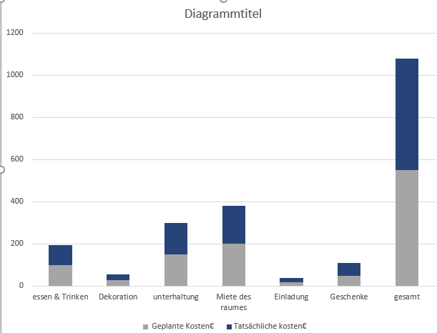

Slide 3
